Slide 1
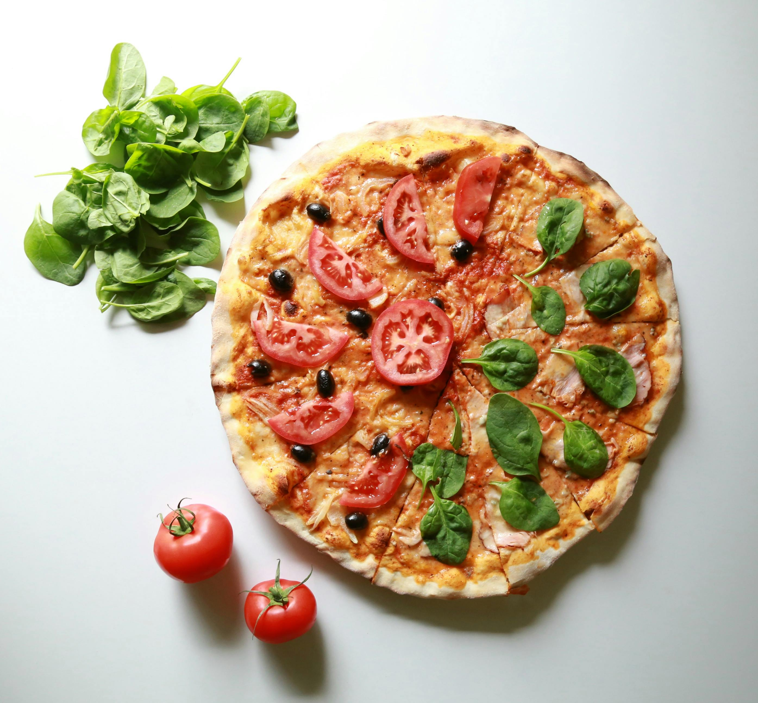
THE PERFECT PIE
ANALYTICS-BACKED TACTICS TO FUEL PIZZA SALES EXPANSION

Slide 2
OVERVIEW
The repository holds an analytical report and interactive dashboard that breaks down a pizza store’s sales. It covers key revenues, category performance, orders over time and suggestable actions to boost sales and streamline operations.

Slide 3
Summary Presentation
Background | $817.86k revenue in management 21.35k orders in 2015 50k Pizzas sold Low credit losses
Key Findings | Most expensive Pizza Most ordered Pizza by category Pizza ordered over time Peak ordering hours Total and average revenue
Recommendation | Grow more revenue under management from $817.86k to $2M over a year Boost profile and raise visibility Highlight and push the most popular pizzas with stronger promotional efforts Schedule more staff to the peak period to boost efficiency and cut down on waiting

Slide 4
Performance Metrics (KPIs)
Total Revenue generated was $817.86k
Total orders placed was 21.35k
Average order value is 10.70k
Total pizza sold was 50k
Total quantity of pizza sold per category is 49,574

Slide 5
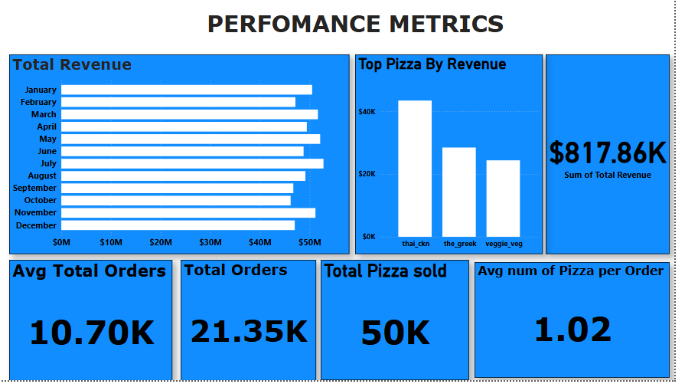
Visualization of Performance Metrics

Slide 6
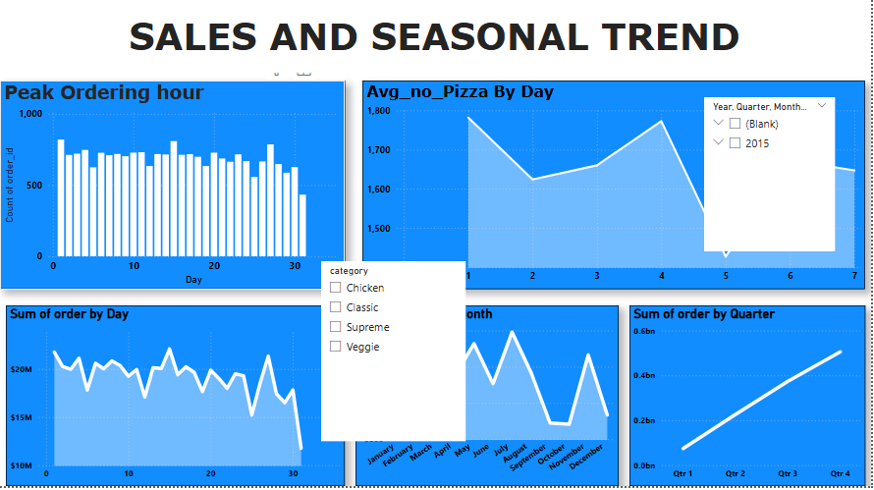
Sales and Seasonal Trend
This dashboard gives a broad snapshot of order, revenue and unit-sold metrics.

Slide 7
Product Performance
Category-wise distribution of pizza
Chicken 11050
Classic 14888
Supreme 11987
Veggie 11649
The most expensive Pizza is the Greek Pizza
The top 5 best selling pizza by number of orders are
The Thai chicken pizza
The pepperoni pizza
The Hawaiian pizza
The barbecue chicken pizza
The classic deluxe pizza

Slide 8
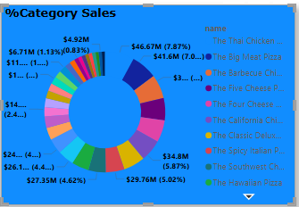
Product Performance contd
Top 3 pizza per category based on sales are
Chicken
Supreme
Classic
Category sales percentage

Slide 9
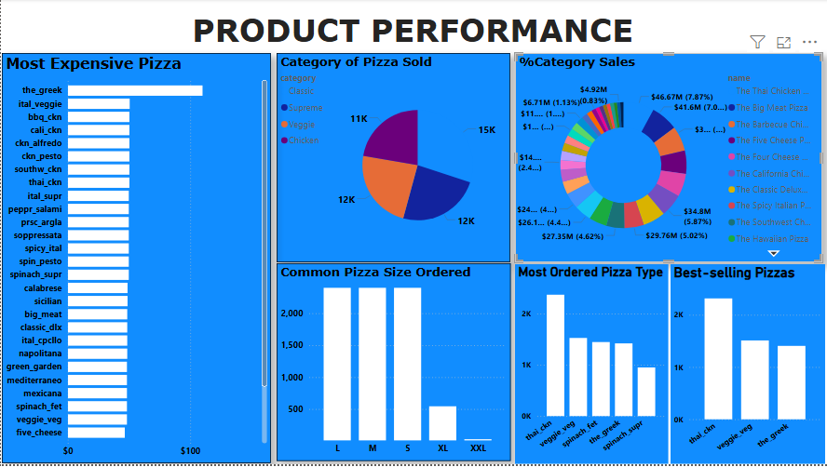
Dashboard of Product Performance

Slide 10
Recommendation for Growth
Promote the best selling pizza (Classic Pizza) – Highlight the top performing Pizza with eye-catchy signals, limited-time discount and stonger promotional efforts.
Leverage data – Use sales dashboards to spot peak times, slow-moving items an adjust inventory and staffs appropriately.
Launch loyalty offers – Reward points for each order to encouraging high orders and purchases.
Expand deliveries location – Set up dedicated delivery teams for and critical operational periods.
Boost profile and raise visibility – Raise awareness and heighten exposure to boost profile to strengthen the brand’s image.
Assign more staff to critical periods - Schedule more staff to the peak period to boost efficiency and cut down on waiting.

Slide 11
THANK YOU

